Slide 1


Hii,
Iam Siddhika
Welcome to Power BI Series
Part -39

Slide 2



Today Content
We focus only on the most used and important Dax Functions
I’m soo Excited.
Are you ready guys?
Meet DAX
COMMON FUNCTION CATEGORIES
5.TABLE MANIPULATION FUNCTIONS(FEW MORE)
VALUES DISTINCT
VALUES VS DISTINCT

Slide 3


VALUES
The VALUES function in DAX can be used in two ways, depending on whether you give it a column name or a table name:
When you use a column name:
It gives you a list of unique values from that column.
If there are any blanks in that column, it will include a blank in the list. If you have a column with categories like "Office Supplies", "Technology", "Office Supplies", it will return "Office Supplies" and "Technology", just once each.
When you use a table name:
It gives you all the rows from that table.
If there are any blank rows in that table, it will include a blank row.
If your table has multiple rows, it will return all those rows exactly as they are, without removing any duplicates.
Syntax
VALUES(<TableNameOrColumnName>)
Check next
Example

Slide 4
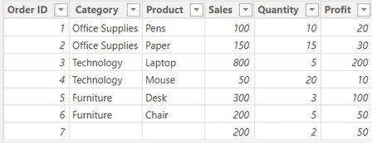
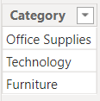

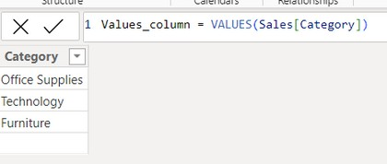
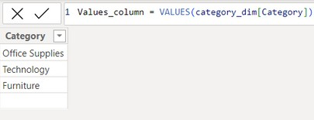

Example
Here just i’m taking for example to understand.
We will use your sales fact table and category_dim table for this example.
sales fact table
category_dim table
We have created a
relationship between the sales table and the category_dim table using the Category column
Understood?
Scenario : Using VALUES with a Column
How can you use the VALUES function to retrieve a unique list of categories from the sales table, including any blank categories?
This can be useful when you want to see all unique categories present in the sales data, even if some of them are missing a category name.
Returns all rows, preserving duplicates and adding a blank row for any missing references.
If we use Values for dim table also, it will give the all unique categories present in the sales data, even if some of them are missing a category name. As both table have relationship. If we delete relationship , It only shows the unique values without blank rows
Using VALUES with a Table : duplicates and blank rows as well.
It gives same as the original table with

Slide 5
DISTINCT
The DISTINCT function in DAX is used to return a one-column table that contains the unique values from a specified column or the unique rows from a specified table. This function is helpful for removing duplicates from your data, which can be useful in various data analysis scenarios.
Check next
Example
Syntax
DISTINCT(<column_name>) or
DISTINCT(<table>)
Here just i’m taking for example to understand.
We will use your sales fact table and category_dim table for this example.
Example
sales fact table
category_dim table
We have created a
relationship between the sales table and the category_dim table using the Category column

Slide 6
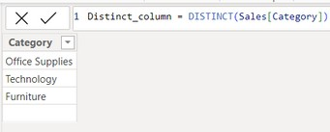
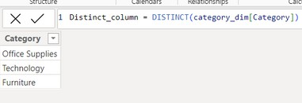
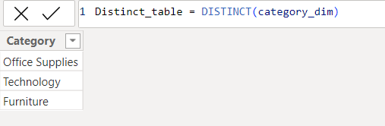
Scenario : Using DISTINCT with a Column
How can you use the DISTINCT function to retrieve a unique list of categories from the sales table, Is it exclude any blank categories?. How it works with category_dim table
It give unique values from sales table and also gives the blank as Values but the difference you can see in below.
Understood?
If we use Distinct for dim table , it will give the all unique categories present in the sales data, and not gives blank rows as VALUES . even both table have relationship.
Using DISTINCT with a Table : It gives same as the original table of fact table with duplicates and blank rows as well. But for dim_table it gives unique without blank

Slide 7
VALUES vs DISTINCT
While DISTINCT and VALUES functions in DAX often produce similar results, there are subtle differences in how they operate, particularly in how they handle tables and relationships.
Similarities
Both functions: Return unique values from a specified column and Include blank values if they exist in the specified column.
check next example
Differences
DISTINCT:
Returns distinct values or distinct rows: When applied to a column, it returns unique values from that column. When applied to a table, it returns unique rows.
Does not add a blank row for tables: If applied to a table, DISTINCT will not add a blank row even if the table contains rows with blank values.
VALUES:
Returns unique values from a column or the entire table with relationships: When applied to a column, it returns unique values from that column. When applied to a table, it returns all rows from that table, including duplicates. Additionally, it can return a blank row to account for relationships with missing references (in the context of a relationship).
Adds a blank row for tables: If the column or table contains relationships and there's no corresponding row, VALUES adds a blank row to represent these missing relationships.

Slide 8
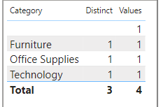
Visual Example for better understanding
Example
How can you use the VALUES function with COUNTROWS to count the number of unique categories, including blanks, in the category_dim table?
Understood?
The VALUES function returns a one-column table with all the unique categories from category_dim, including any blank categories. COUNTROWS then counts the number of rows in this one-column table, giving the total count of unique categories, including any blank values.
How can you use the DISTINCT function with COUNTROWS to count the number of unique categories, excluding blanks, in the category_dim table?
The DISTINCT function returns a one-column table with all the unique categories from category_dim, excluding any blank categories. COUNTROWS then counts the number of rows in this one-column table, giving the total count of unique categories, excluding any blank values.
We'll use the above measures in a table visual that includes the categories and these measure
ValuesCount:
This measure counts the unique categories, including the blank value. Since VALUES includes the blank, it counts 4 unique categories.
DistinctCount:
This measure counts the unique categories, excluding the blank value. Since DISTINCT excludes the blank, it counts 3 unique categories.

Slide 9


Thank you for joining me today to learn about Part -39 of Power BI!
Remember, Learning DAX is key to unlocking the full potential of Power BI for insightful reporting and visualization.
Stay tuned for more insights and tips on Power BI in our next Series.
Follow
Siddhika Shah

